Slide 1
Node Js
Node.js® is a JavaScript runtime built on Chrome's V8 JavaScript engine.

Slide 2
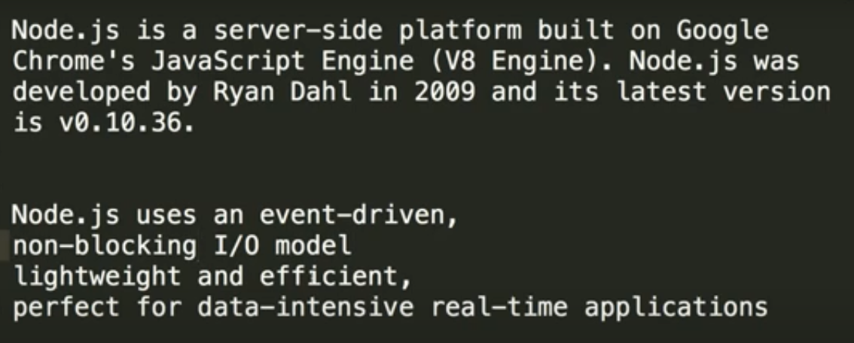
Introduction to Node.js

Slide 3
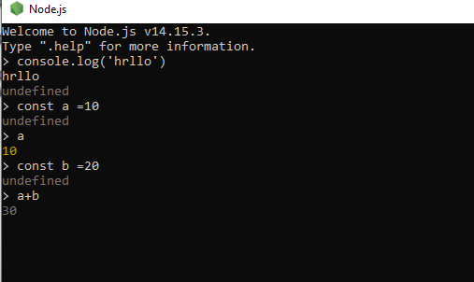
Node (ctrl+c)exit

Slide 4
RUN :node main
node --version
npm --version
npm (package install)
npm command : -npm init
npm install express --save
npm i (install)
npm i -g nodemon (package)
nodemon main.js

Slide 5
Dev dependency
ye bo dependency h jo devlpment ke time par use karna chahege..
npm install --save-dev nodemon
npm uninstall nodemon
npm uninstall ex
----
npm i express
npm i @angular/cli

Slide 6
Import export file data
const ram = require("./second");
console.log("hello world",ram)
module.exports =pn;

Slide 7
Object, Anonymous and Arrow Function
var user ={
name :"raj",
age : 28,
email :"jain@gmai.com"
}
console.log(user)
console.log(user.name)

Slide 8
Anonymous
Anonymous :ye bo function hote h jin ka koyi name nahi hota.
var itm = function(a,b){
var c =a+b
console.log("Hello ITM")
console.log("Addition of a and b =" +c)
}
itm(4,6)

Slide 9
Arrow Function
var user=(a,b)=> {
var c =a+b
console.log("This is arrow function with para="+c)
}
user(4,5) //parameter

Slide 10
Global Object
__dirname
__filename
require
buffer
module
exports

Slide 11
module wrapper function in nodejs

Slide 12
What is ECMAScript 2015 or ES6
let ,const ,templating string, class

Slide 13
Prototype

Slide 14
Module in node.js

Slide 15
node.js http module server create
const http = require("http");
const server =http.createServer(function(req,res){
res.writeHead(200,{"content-type":"text/html"}); //plain
res.write("<h1>Node Js PNINFSYS</h1>")
res.end();
}).listen(3000,()=>console.log("Server is Running posrt 3000")); //event //function 2 paramenter pass

Slide 16
Nodemon Installation
https://www.npmjs.com/package/nodemon

Slide 17
File System Module

Slide 18
Sync and Async function in file system

Slide 19
Create and Trigger Custom Event in Node.js

Slide 20
What is express js?
How to install express?
New Folder Express js
https://expressjs.com/
npm init
entry point: (index.js)
npm install express --save

Slide 21
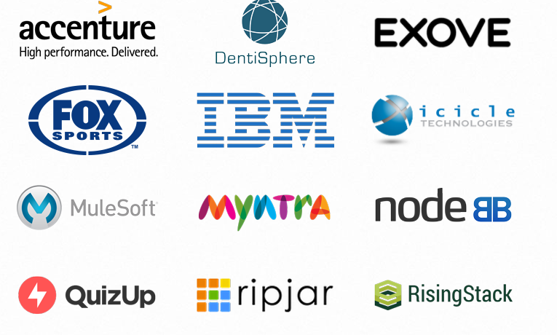
Compnay use Expressjs

Slide 22
Using template engines with Express
https://expressjs.com/en/guide/using-template-engines.html
Pug
EJS

Slide 23
Express Application Generator
npm install -g express-generator
express -h
express --view=ejs myapp
npm install
npm start

Slide 24
Basic routing
app.get("/",(req,res)=>{
res.send("Hello world");
});
app.get("/users",(req,res)=>{
res.send("Hello user");
});

Slide 25
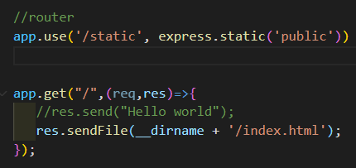
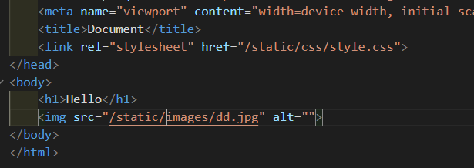
How to use Static Files in Express
public floder create->css->image
https://expressjs.com/en/starter/static-files.html

Slide 26
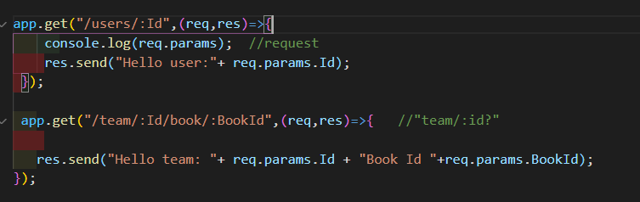
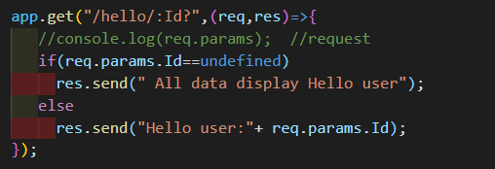
Create Route with Parameters using

Slide 27
Thunder Client api
ctrl+shift+p
thunder client

